Slide 1
MULTIMEDIA CODING Final Project: A JPEG-like coding system for color images
Giovanni Gallinaro
ID: 1210127

Slide 2
A JPEG-like coding system for color images
OBJECTIVES:
Build a JPEG-like coding system
Compare the results
STRUCTURE OF THE PRESENTATION:
Introduction to JPEG
Technical approach to the problem
Discussion of the results

Slide 3
JPEG standard
Introduced in 1992
Lossy type of compression
Basic idea: concentrate information in few samples
PROS | CONS
Amount of compression Loss in details | Not suitable for multiple edits
Tunable quality of the compressed image | No transparency allowed
Good for high-quality phorographs | Not good for sharp lines and shapes

Slide 4
JPEG standard
PROCEDURE:
Pre-processing
Discrete Cosine Transform (DCT) on 8x8 blocks
Quantization of the DCT coefficients
Huffman coding on the quantized coefficients

Slide 5

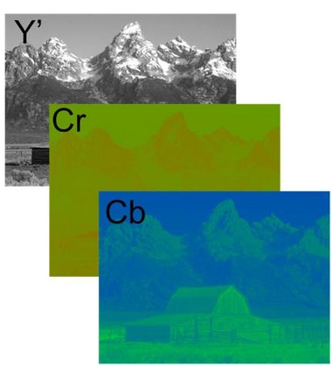
Preprocessing
IMAGE PADDING:
Number of rows and columns must be multiple of 8
COLOR SPACE CONVERSION:
Convert from RGB to YCbCr: linear operation
Y component -> most perceived by the human eye
-> more compact representation
Y | Luminance
Cb | Blue difference
Cr | Red difference
Chroma components

Slide 6
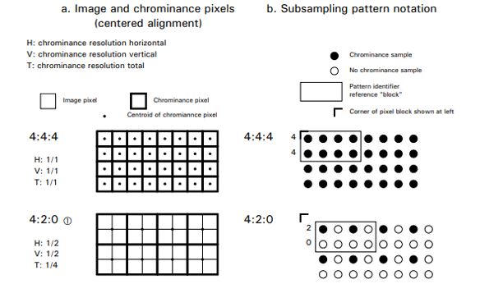
Chroma subsampling
Chroma components can be downsampled
Quality of the final result not too affected

Slide 7

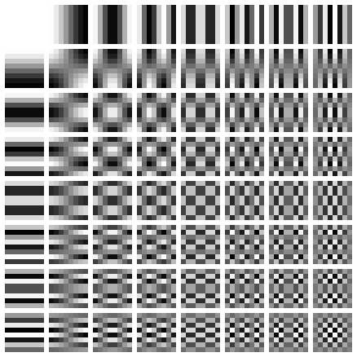
Discrete Cosine Transform
Partition the image into blocks of 8x8 pixels
Apply DCT to each block -> more compact representation
64 patterns -> basis functions
Top left corner -> DC coefficient
Low-frequency, better perceived by human eye
Other 63 coefficients -> AC coefficients

Slide 8
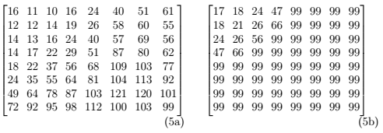


Quantization
Use of quantization tables
Result given by a rounding
Possibility of tuning the amount of quantization -> quality factor (default = 50)
Finer quantization step size for low frequency coefficients -> more compact representation

Slide 9
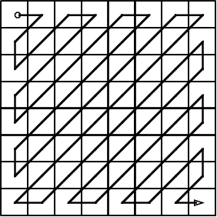
Encoding
AC and DC disposed using a zigzag scan
Different encoding for DC and AC coefficients:
AC -> defined by the pair {size, skip}
DC -> delta measure between adjacent blocks
Both encoded using Huffman coding

Slide 10
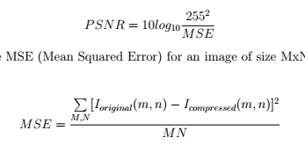
Results
Measures to evaluate the performace:
Size of the encoded image [kB]
Compression ratio =
Computational complexity [seconds]
bpp =
PSNR [dB]
Original image size
Compressed image size
Compressed image size
Number of pixels
where

Slide 11
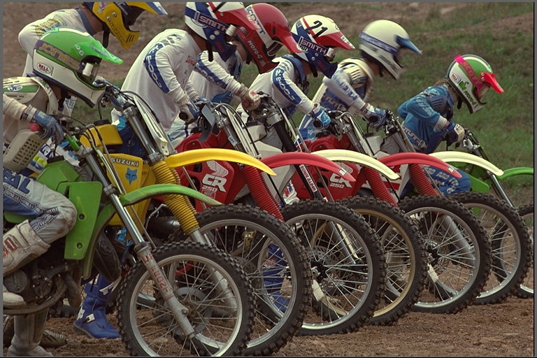
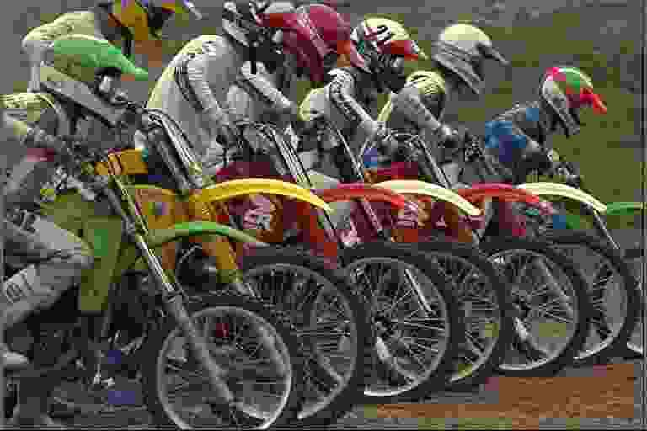
Results
Original image
Compressed with quality = 5

Slide 12
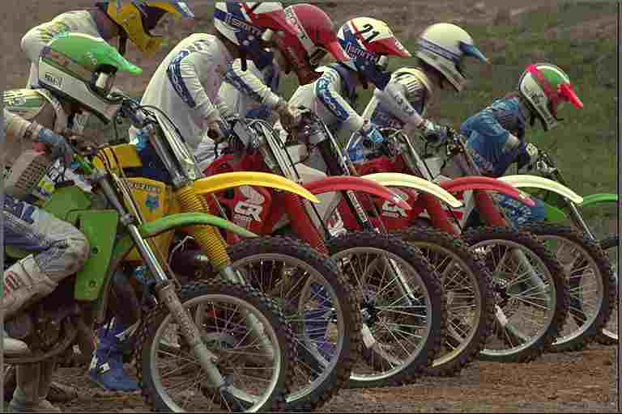
Results
Original image
Compressed with quality = 15

Slide 13

Results
Original image
Compressed with quality = 30

Slide 14

Results
Original image
Compressed with quality = 50

Slide 15

Results
Original image
Compressed with quality = 80

Slide 16
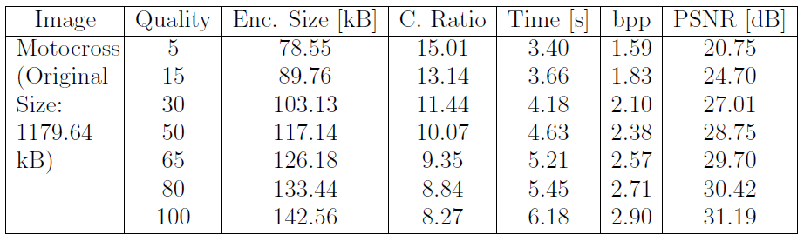
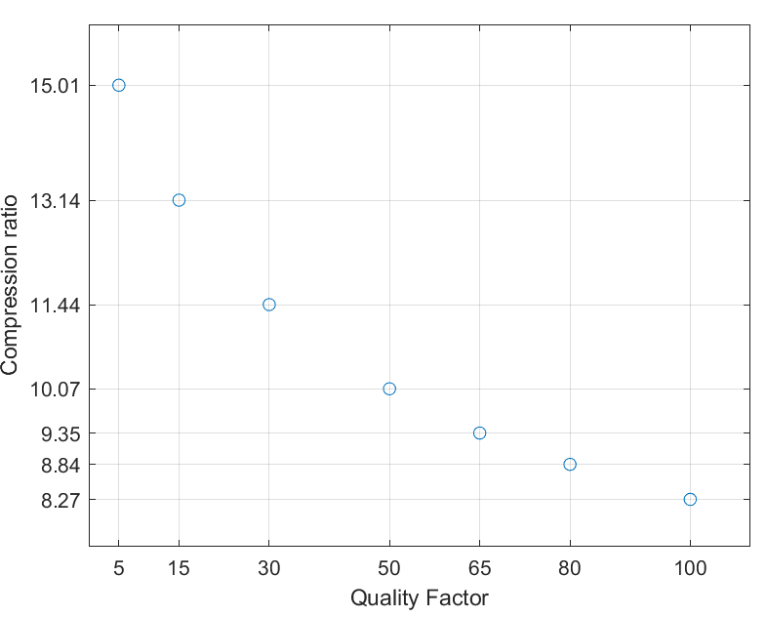
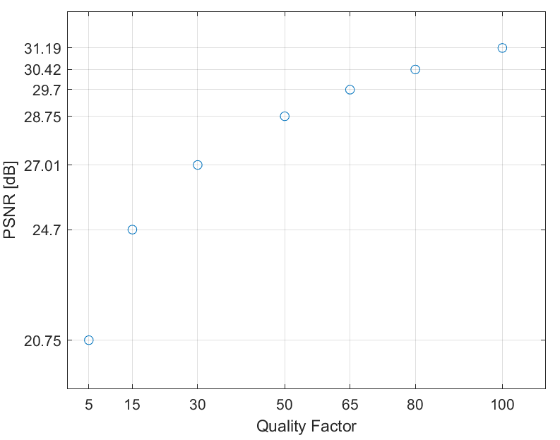
Results

Slide 17
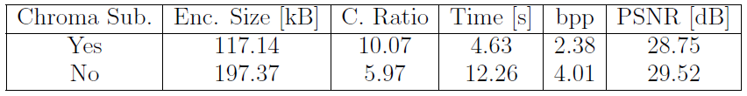
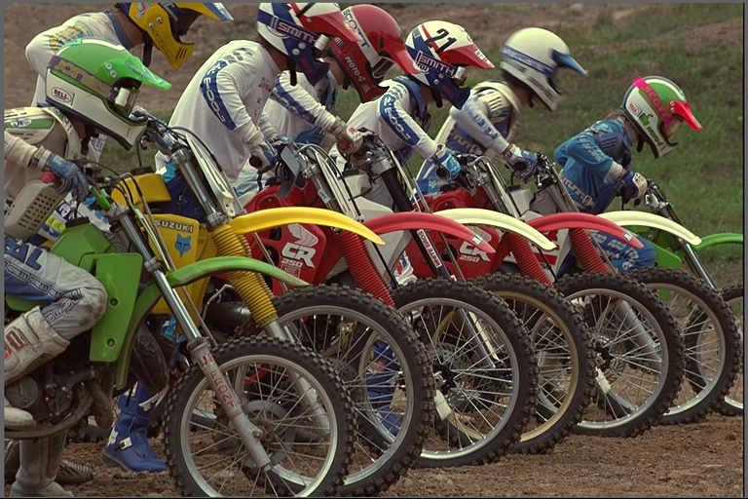
Results
With chroma subsampling (Quality = 50)
Without chroma subsampling (Quality = 50)

Slide 18
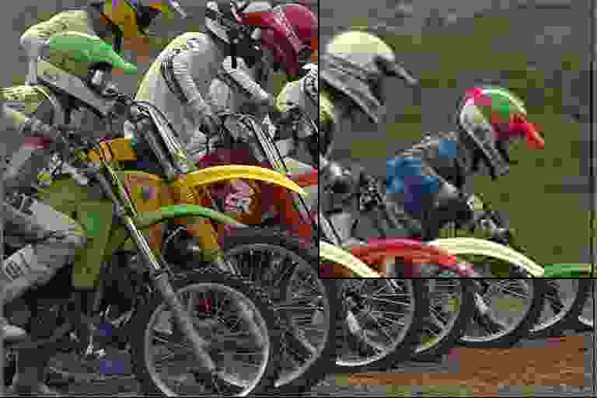
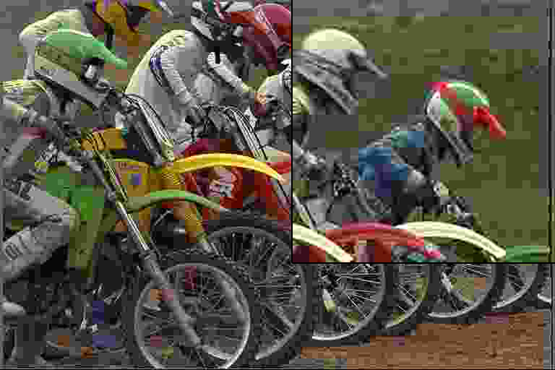
Results
JPEG-like approach (Quality = 5)
Standard JPEG (Quality = 5)

Slide 19
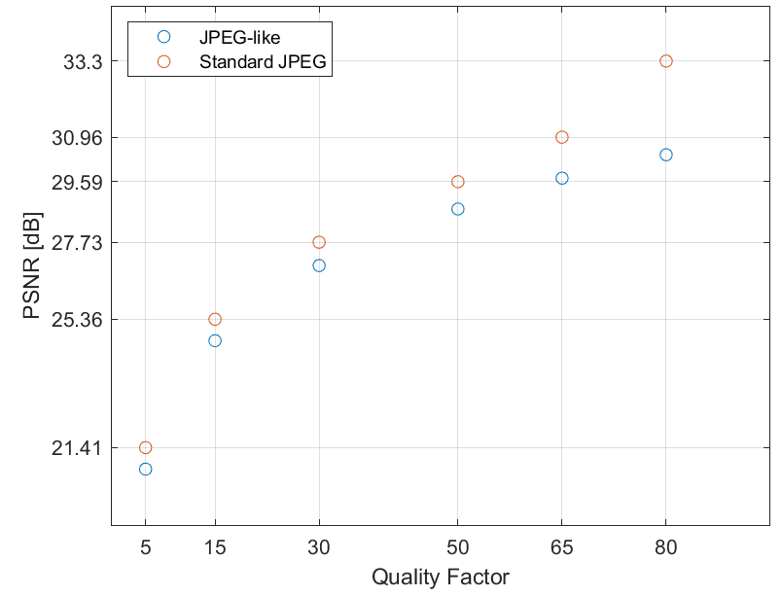
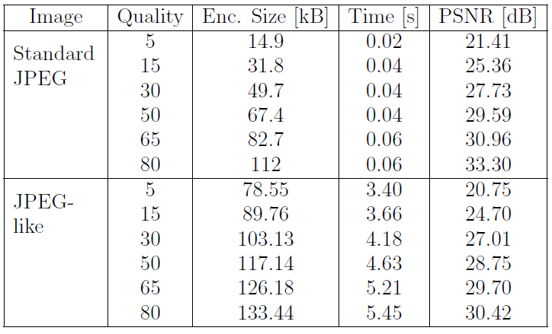
Results

Slide 20

Results
JPEG-like approach (Quality = 15)
Standard JPEG (Quality = 15)

Slide 21

Results
JPEG-like approach (Quality = 50)
Standard JPEG (Quality = 50)

Slide 22

Results
JPEG-like approach (Quality = 80)
Standard JPEG (Quality = 80)

Slide 23
Thank you for your attention

